Slide 1
Task 4: Dashboard Design
Sales Performance Dashboard using Power BI
By: Anjana V K

Slide 2
Objective
Design an interactive sales dashboard using Power BI.
Analyze sales performance using key business metrics.
Provide meaningful insights for business stakeholders.
Enable interactive analysis using filters and visualizations.

Slide 3
Dataset
Sales-Export_2019-2020.csv
1000 sales records
Includes sales, cost, profit, customer, country, category, device type, and date.
Tools Used
Power BI
Power Query
DAX

Slide 4
Dashboard Features
KPI Cards
Total Sales
Total Cost
Total Profit
Total Orders
Profit Margin
Interactive Slicers
Country
Category
Device Type
Visualizations
Monthly Sales Trend
Sales by Country
Sales by Category
Sales by Device Type
Sales by Sales Manager
Sales by Sales Representative
Top 10 Customers

Slide 5
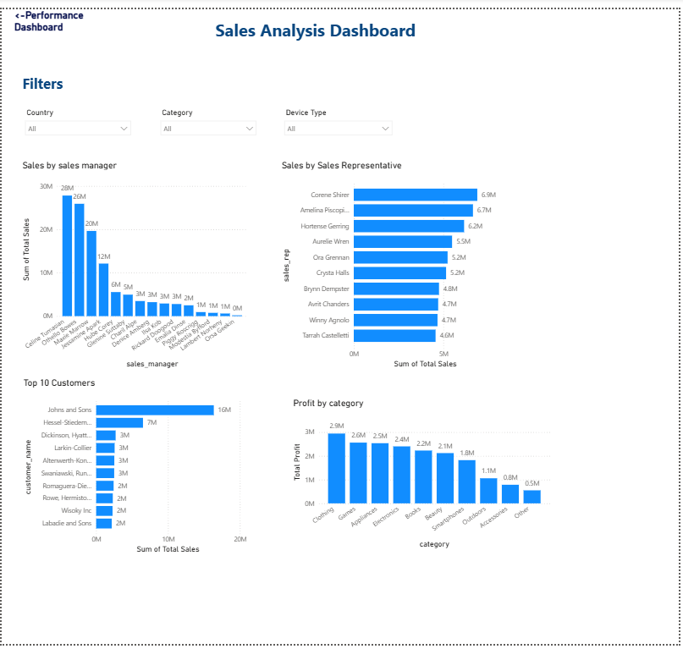
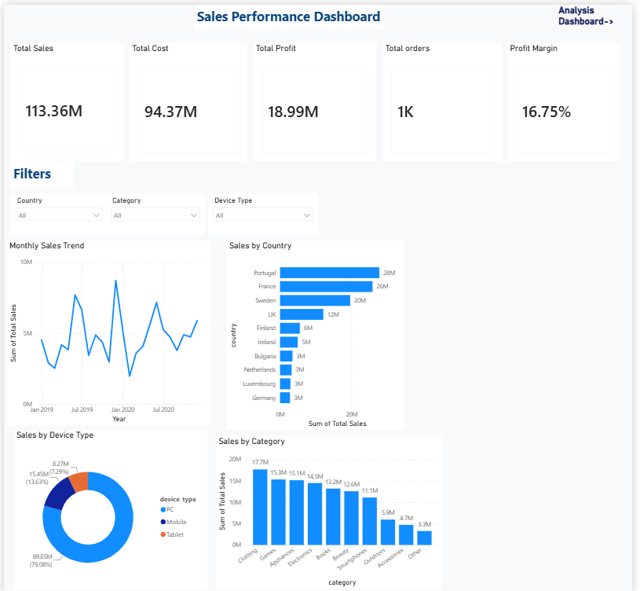
Dashboard Summary
Built a two-page interactive dashboard.
Used DAX measures to calculate key performance indicators.
Added filters for dynamic analysis.
Used appropriate charts to visualize business performance.

Slide 6
Key Insights
Clothing category generated the highest sales.
PC devices contributed the highest sales.
Sales performance varies across countries.
Top customers contribute significantly to revenue.
Profit Margin is approximately 16.75%.
Conclusion
The dashboard provides an interactive view of sales performance.
It helps stakeholders monitor KPIs and make data-driven business decisions

